Slide 1
What Role Should Consumerism Play in our Economy?
Chapter 7

Slide 2
Consumerism Ideas That Changed the World
What is the producer’s bias?
Did the focus of the video change you view toward producing habits?
Will you change your consuming habits because of this video?
Why isn’t society trying to solve these problems

Slide 3
Consumerism
Consumerism is an economic theory that links prosperity to consumer demand for goods and services, and that makes consumer behaviour central to economic decision making
HUH!
Basically the more people buy, the better it is for the economy
When you buy good and services you become a consumer
Have you ever thought about what influences you as a consumer?
Quality, price, brand name, laws, health and safety
Is consumerism a good thing or a bad thing?

Slide 4
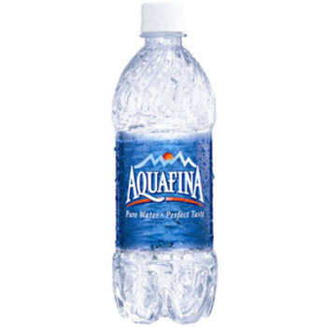
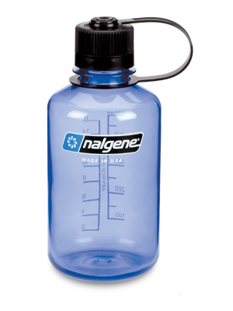
Consumer Choices
why would you choose a Aquafina bottle over a refillable bottle?
Why would you buy Nalgene bottle and not a no name brand?
What impact does your choice have on the environment?

Slide 5
The Story of Stuff
Watch the video and make notes about each concept on the sheet provided

Slide 6
Lets Think….
Based on the example on pg 239, what challenges and opportunities can consumerism create?
To what extent does consumer behavior affect jobs and products available to people?
Why might understanding the role of marketing be important to you as the consumer?
How can consumers act together to bring about change?

Slide 7
How does Consumer Behavior Affect Quality of Life for Individual and Groups in Canada and in the U.S.?
Why do we buy the things we do?
what is the connection between the consumer and the economy?
What techniques do marketers use to influence the consumer?
How does the government influence consumers?

Slide 8
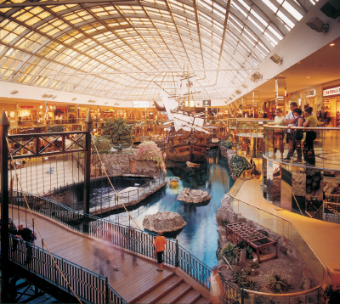
What Guides Your Behavior as a Consumer?
Its Saturday afternoon and you are going to WEM. By some miracle, you have money to spend. Why will you spend the money on the products you buy? What will influence you?
How will your identity (who you are, what you believe in, the groups you belong to) come into play?
How much will you consider your health?
How does choosing a product affect the jobs people have?
How does choosing a product affect the environment?
How will marketing affect what you buy?
Do you really NEED to buy anything at all?

Slide 9
Factor 1- Identity
The choices we make as consumers affect our identity. Think about the clothing you are wearing today.
What do the clothes you are wearing say about beliefs and values, and what you consider to be important to your quality of life?
Read the comments made by the grade 9 students on pg 244-245. they each have a different view on how clothing represents their identity
What do these view say about their behavior as consumers?
How do these ideas compare to your own?

Slide 10
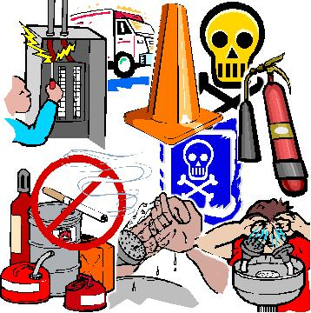
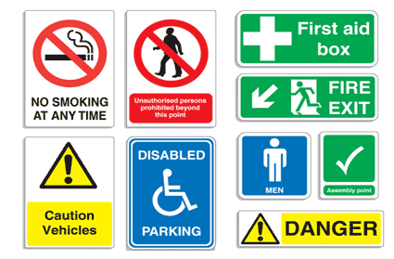
Factor 2- Health and Safety
How much will you consider your health, Safety, and security when buying products?

Slide 11
How does legislation affect consumer behavior?
Many consumers make bad decisions that can negatively impact the Q of L of society. In such cases, it is necessary to have consumer safety legislation in place to protect citizens.
Governments in CAN and USA support consumers by: (examples?)
Encouraging a healthy economy – so consumers can afford quality-made goods.
Assist consumers in making informed decisions – product labeling and safety standards laws
Ensure consumer protection – environmental standards, fraud and counterfeit laws

Slide 12
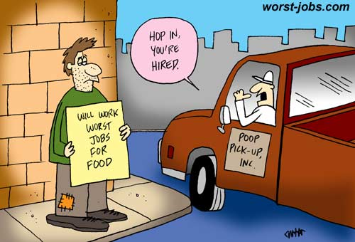
Factor 3- Jobs
How does choosing a product affect the jobs people have?

Slide 13
Consumer choices affect the job market
Consumer spending dictates which sectors of the economy and types of industries will experience growth.
Industries in which many jobs are available (labor shortage) will usually be producing a good or service in high demand.
Consumer spending accounts for 70% of economic activity in the USA and 60% in Canada. Both governments watch consumer spending closely to judge economic growth (degree to which a country’s wealth increases over time).

Slide 14
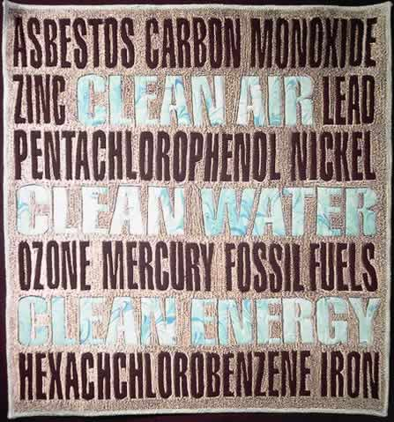
Factor 4-The Environment
4-How important to you are the environmental impacts of products and services?

Slide 15
The environmental impact of consumerism
The production, packaging and sale of all products you buy have an impact on the environment
Legislation in both Canada and the USA has been passed to help consumers make environmentally friendly choices
Ex) Energuide labels on appliances
Many companies have shifted toward environmentally friendly products due to consumer demand
Ex) organic food

Slide 16
Is it time to change our buying habits?
Think back to a recent purchase. Lets Create a chart that shows:
The materials used from start to finish
Where these materials come from
How they are used to create the finished product
Effects these materials have on environment after disposal

Slide 17

Factor 5-Marketing
How will marketing affect what you buy? Do you really need to buy anything at all?

Slide 18
Who is really making our consumer decisions?
Marketing – the way in which companies convey knowledge about their product to the masses (with the goal of influencing consumer choices).
Marketing (also known as advertising) has become a huge industry in itself – employing millions of people working to attract your $$$. These people work to manipulate consumer behavior.

Slide 19
Marketing Techniques
The following is a list of techniques that marketers use to get you to buy their products.
Bandwagon effect
Emotional appeal
Glittering generalities
Plain folks appeal
Testimonials
Scientific appeal

Slide 20

Bandwagon Effect- encourages you to buy a product or service because everyone else is

Slide 21

Emotional Appeal- uses strong emotional language that connects with your fears and desires

Slide 22
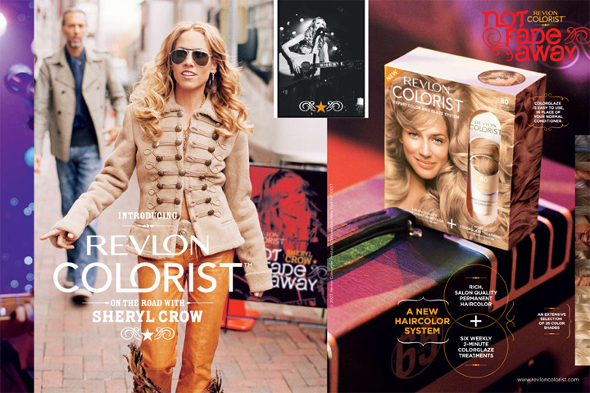
Glittering Generalities- relates the product or service to words or images that promise everything, but deliver little or nothing

Slide 23

Plain Folk Appeal- relates a product or service to the experiences of ordinary folks

Slide 24
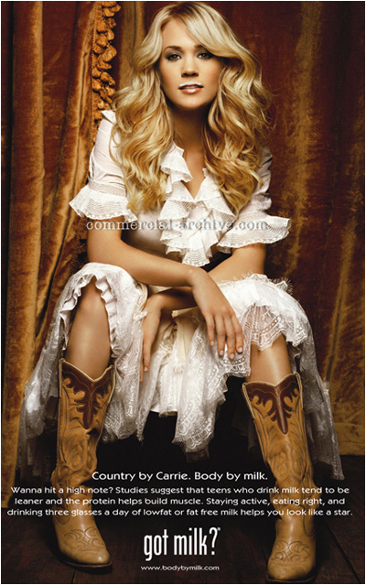
Testimonials- uses celebrities or experts to speak for a product

Slide 25
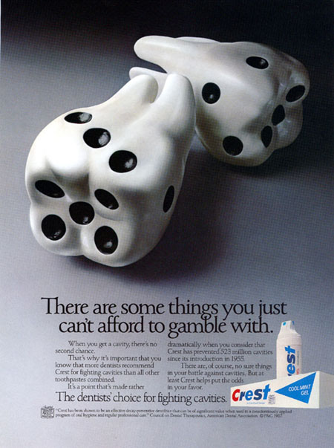
Scientific Appeal- uses statistics or scientific data to persuade consumers to buy a service or product

Slide 27
Cartoons about Consumerism
Examine the cartoons presented on p. 256 of your textbook.
What issues about consumer behavior do they raise?

Slide 28
Consumerism and Income
Look at the cartoon on p. 258-260 of your textbook.
What influences John’s behaviour as a consumer?
How does his income affect his decisions?

Slide 29
What is GDP??
Gross Domestic Product (GDP) is a per capita (per person) measure of the wealth a country’s economy produces.
For example, GDP in 2007:
Canada: $33 000
USA: $46 000
Mexico: $12 500

Slide 30
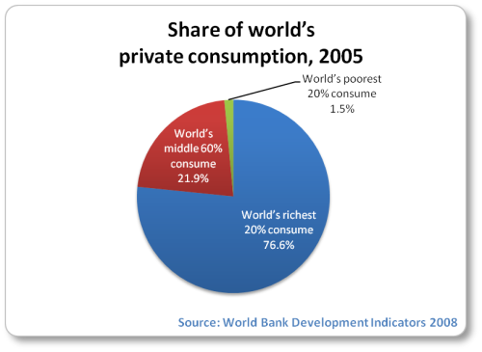
The higher the GDP, the more consumption!

Slide 31
Income Disparity
Disparity – difference, inequality
Not everyone living within the same region experiences the same prosperity.
For example: inner-city Edmonton vs. the suburbs
Factors increasing the likelihood of poverty include:
Low education
Single-parent families
Member of at-risk group: elderly, refugees

Slide 32
How can consumerism empower groups?
Consumers in Canada and the USA have the right to:
safe products
Ex) regulation of food
information about the products
Ex) laws against false advertising
choice between multiple products
Ex) anti-trust laws to prevent monopolies
be heard; to voice their concerns
Ex) creations of government agencies to voice consumer concerns

Slide 33
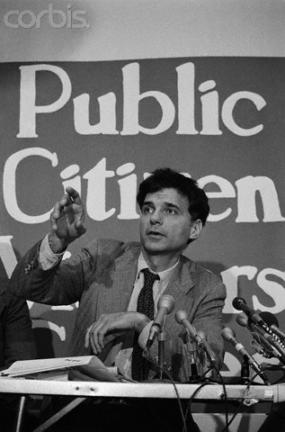
Protecting the Consumer
Consumer advocates fight for more government controls and regulations to ensure consumer safety.
Example - Ralph Nadar
Ralph Nader took on General Motors, criticizing automakers’ resistance to update safety features in his book Unsafe at Any Speed

Slide 34
Governments respond to consumer pressure because if they do not give them what they want, they face consequences come election time!

Slide 35
Therefore, there must be balance!
The task of balancing the rights of consumers, the rights of businesses and the involvement of government in an economy is a difficult one!
In a market economy, the rights of business and the rights of consumers should naturally come to equilibrium with limited government intervention.

Slide 36
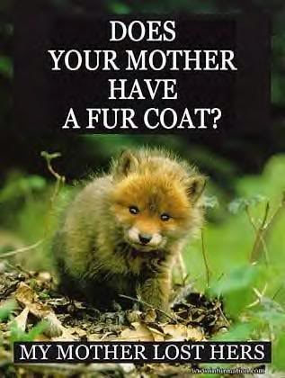
Boycotting
A boycott is a form of consumer activism involving the act of voluntarily abstaining from using, buying, or dealing with a person, organization, or country.
Ex) PETA encourages people to avoid buying fur
Olympic Boycott

Slide 37
Other Examples…
Read through the case studies on p. 263.
To what extent do the boycotts described reflect collective identity?

